Slide 1
Katherine Ao Kit I M.Sc. in Data Science (Data Strategy and Compliance) Student No: MC660004 Email: mc66000@um.edu.mo
LI YING FANG M.Sc. in Data Science (Data Strategy and Compliance) Student No: MC661599 Email: mc66159@um.edu.mo
Tom Ho Man Hou M.Sc. in Data Science (Data Strategy and Compliance) Student No: MC661647 Email: mc66164@um.edu.mo
WU PEI YE M.Sc. in Data Science (Data Strategy and Compliance) Student No: MC661846 Email: mc66184@um.edu.mo
LI TIAN HAO M.Sc. in Data Science (Data Strategy and Compliance) Student No: MC663312 Email: mc66331@um.edu.mo
Savidi Avram M.Sc. in Data Science (Data Strategy and Compliance) Student No: MC664364 Email: mc66436@um.edu.mo
CISC7204 CLASS K-TEAM 01
Data Science and Data Visualization
CISC7204 Class K-Team 01
Project Work Plan
Academic Year 2026/2027 Semester 1
Submitted: 29 October 2026
Student Name | Student ID
AO KIT I | MC660004
LI YING FANG | MC661599
HO MAN HOU | MC661647
WU PEI YE | MC661846
LI TIAN HAO | MC663312
Savidi Avram | MC664364

Slide 2

CISC7204 CLASS K-TEAM 01
LI TIAN HAO
MC663312
Class k-Team 01
CISC7204 Data Science and Data Visualization
LI YING FANG
MC661599
Class k-Team 01
CISC7204 Data Science and Data Visualization
WU PEI YE
MC661846
Class k-Team 01
CISC7204 Data Science and Data Visualization
HO MAN HOU
MC661647
Class k-Team 01
CISC7204 Data Science and Data Visualization
AO KIT I
MC660004
Class k-Team 01
CISC7204 Data Science and Data Visualization
Savidi Avram
MC664364
Class k-Team 01
CISC7204 Data Science and Data Visualization
Student Name | Student ID
AO KIT I | MC660004
LI YING FANG | MC661599
HO MAN HOU | MC661647
WU PEI YE | MC661846
LI TIAN HAO | MC663312
Savidi Avram | MC664364

Slide 3
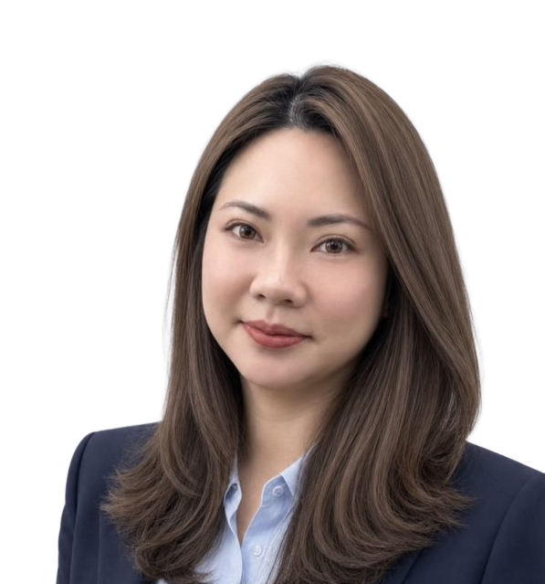



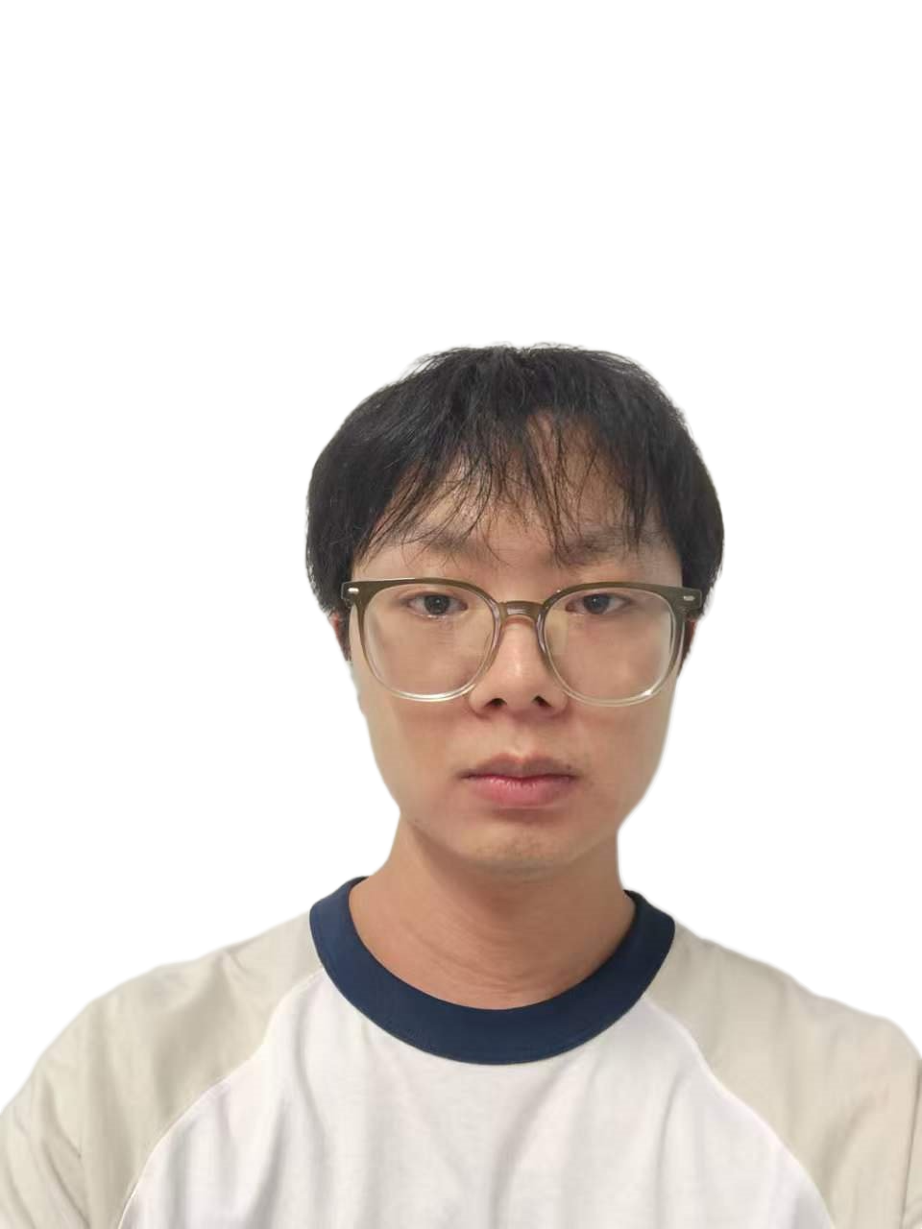
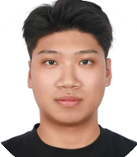
CISC7204 / K-TEAM 01
Eight Course Roles Strategically Distributed Across Six Team Members
The team combined the eight required roles to optimize workflow, ensuring comprehensive coverage while maintaining a balanced workload across all six members.
Team Coordinator & Project Tracker
AO KIT I
MC660004
Serves as Team Coordinator and Project Tracker to streamline team workflows and track key deliverables.
Lead Project Developer
LI YING FANG
MC661599
Acts as the Lead Project Developer, directing technical execution and primary asset creation.
Project Developer
SAVIDI AVRAM
MC664364
Supports development tasks as the second Project Developer to accelerate technical milestones.
Team Scribe
HO MAN HOU
MC661647
Acts as Team Scribe, responsible for detailed meeting minutes and official project documentation.
Team Reporter & Liaison
WU PEI YE
MC661846
Handles Team Reporter and Liaison duties, managing external communications and progress reporting.
Project Analyst & Quality Reviewer
LI TIAN HAO
MC663312
Manages Project Analyst and Quality Reviewer responsibilities to ensure rigorous standards.

Slide 4
CISC7204 / K-TEAM 01
Strict Protocols Ensure Consensus-Driven and Evidence-Based Decisions
Core Governance & Scope Mandate
Our governance framework requires a quorum of five members for formal decisions. Any changes to the project scope or stated requirements mandate unanimous agreement from all six members.
Voting Protocols
Consensus Standard: Consensus is the default approach for all formal team discussions and operational decisions.
Escalation Mechanism: If consensus fails after two full rounds of deliberation, a simple majority vote strictly resolves the issue.
Technical & Requirement Protocols
Technical Disputes: Technical disagreements are strictly settled by data and evidence provided by the Analyst, rather than seniority.
External Consultation: The Liaison consults the instructor before modifying any published requirements.

Slide 5
CISC7204 / K-TEAM 01
Deliverable-Based Work Division Guarantees Independent Peer Review
Work is divided by deliverable to ensure every output has one dedicated owner and one independent reviewer. A strict rule dictates that no member can produce and approve the same item.
The Scribe maintains a single source of truth for decisions, which the Reporter uses to build a consistent final narrative.
DELIVERABLE
PRIMARY OWNER
INDEPENDENT REVIEWER
Analysis Deliverables
Analyst & Quality Reviewer
Developer
Technical Outputs
Developer
Analyst & Quality Reviewer
GOVERNANCE PRINCIPLE
Strict Separation of Production & Approval
To maintain absolute objectivity, no team member is permitted to evaluate their own output. Peer reviews are systematically decoupled across overlapping operational roles.
Final Narrative & Report
Reporter
Scribe
(Source of Truth Audit)
Decision Repository
Scribe
Reporter
(Consistency Verification)

Slide 6
CISC7204 / K-TEAM 01
Structured Phasing Drives Delivery for the November 5 Artefact Deadline
The initial schedule is built backward from the final deadline to ensure timely submission.
OCT 28-29
Team formation, roles agreed, and submission of the photograph set and Work Plan 1 by 23:00.
OCT 30 - NOV 2
Confirm project topic, fix scope, identify data sources, and outline the proposal.
NOV 3-4
Parallel production of the proposal and introductory video, including an internal review and full rehearsal.
NOV 5 — FINAL DEADLINE
Final quality gate and submission of all three project artefacts by 23:00.

Slide 7
CISC7204 / K-TEAM 01
Five Weekly Meetings Maintain Momentum and Track Project Dependencies
The team conducts five weekly meetings, blending in-class sessions and online collaboration. M1 and M2 utilize in-class time to finalize roles, proposals, and rehearsals. M3 through M5 are scheduled as one-hour online sessions on Wednesday evenings to track post-deadline progress.
MEETING
FORMAT & TIME
PRIMARY FOCUS & OBJECTIVES
M1 – M2
In-Class Sessions
Finalize team roles, project proposals, and conduct presentation rehearsals.
M3 – M5
1-Hr Online (Wed Eve)
Track post-deadline progress and review ongoing deliverable updates.
MANDATORY STANDING AGENDA PROTOCOL
Task Board Progress: Systematic review of active deliverables and completion metrics.
Blockers & Dependencies: Early identification of technical impediments and critical path alignment.
Decisions & Assignments: Executing required project decisions and binding action item distribution.

Slide 8
CISC7204 / K-TEAM 01
Clear Ownership of Artefacts and Outstanding Project Variables
Artefact Sign-Off & Deliverables Schedule
All six members formally accepted their roles and the schedule on October 29, 2026. Upcoming deliverables for November 5 include designated owners and reviewers:
Deliverable 01
Project Proposal
Designated Owner & Reviewer Assigned
Deliverable 02
Meeting Minutes
Designated Owner & Reviewer Assigned
Deliverable 03
Introductory Video
Designated Owner & Reviewer Assigned
Key Open Items & Outstanding Variables
Analyst
Must finalize the research question and data sources.
Tracker
Will build the detailed day-level plan.
Reporter
Will confirm video format requirements with the instructor.

Slide 9
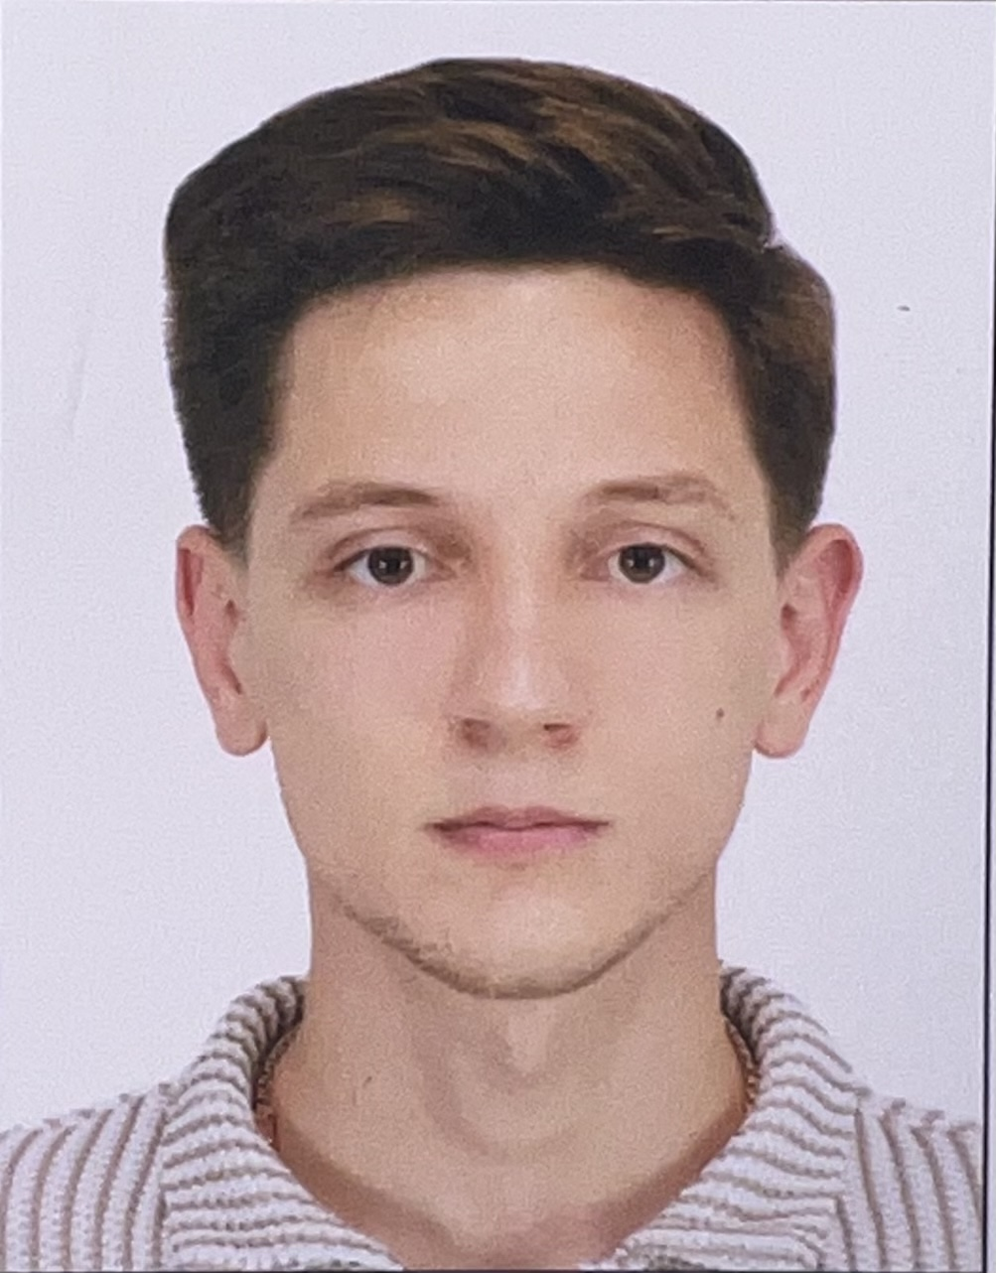
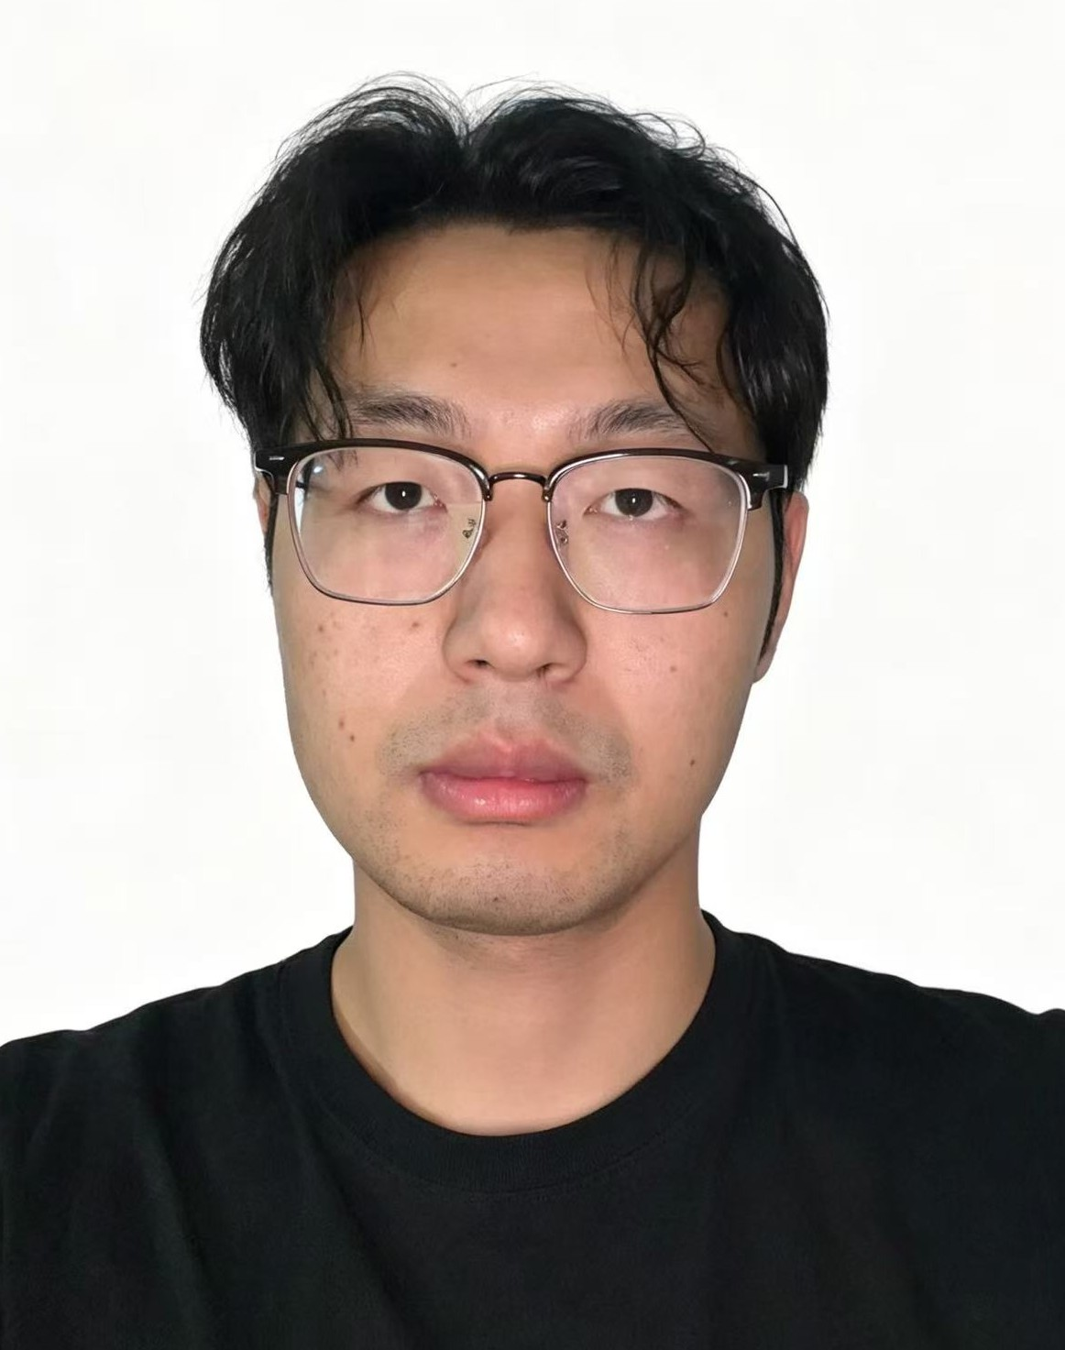
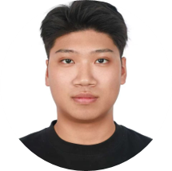
Team member individual photos
AO KIT I
LI YING FANG
HO MAN HOU
WU PEI YE
LI TIAN HAO
Savidi Avram
MC660004
MC661599
MC661647
MC661846
MC663312
MC664364
Class k-Team 01
CISC7204
Data Science and Data Visualization
Class k-Team 01
CISC7204
Data Science and Data Visualization
Class k-Team 01
CISC7204
Data Science and Data Visualization
Class k-Team 01
CISC7204
Data Science and Data Visualization
Class k-Team 01
CISC7204
Data Science and Data Visualization
Class k-Team 01
CISC7204
Data Science and Data Visualization
Class k-Team 01
CISC7204 Data Science and Data Visualization

